Slide 1
Sorting Algorithms
In Depth
This powerpoint and other content are at:
https://github.com/wai-t/CompSci/tree/main/ComputerScience/Sorting

Slide 2
Reminder
Unlikely you will have to implement these algorithms
Standard Libraries are VERY good
By dissecting these algorithms, you:
Learn how to analyse algorithms in general
Become aware of the need to consider edge cases
Become opportunistic about possibilities to optimise the algorithm
Improve the content of your CV
Speak with confidence in your interviews and meetings
Approach Coding Challenges in a more structured and efficient way

Slide 3
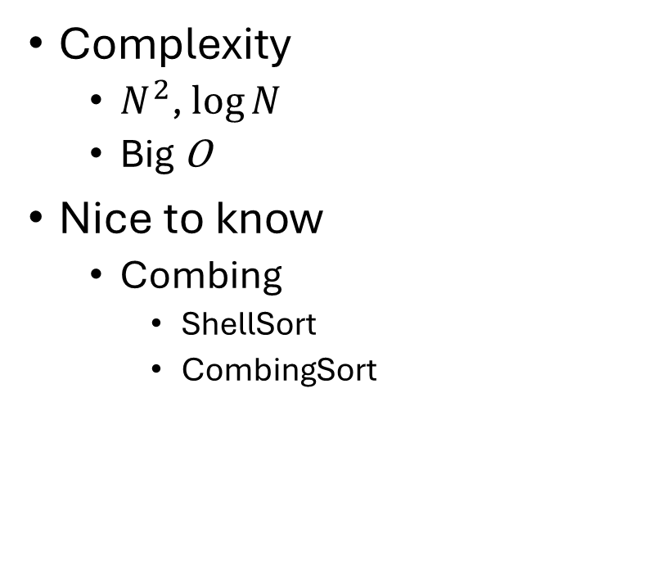
Agenda
5 to remember
Insertion (did last week)
Selection
Bubble
Merge (did last week)
Quick
2 easy ones
Radix
Counting
Complexity
$N^{2}$, $\log{N}$
Big O
Nice to know
Combing
ShellSort
CombingSort

Slide 4

Job Interview Skills
https://youtu.be/m4yVlPqeZwo?si=CDUEO8g9_W-EQar_&t=1372

Slide 5
Insertion Sort
We did this last week – quick revision

Slide 6
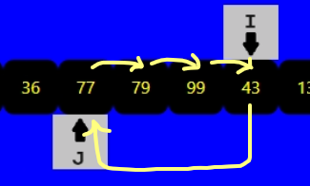
Insertion Sort
I
Outer loop (slower)
21
79
7
19
77
99
36
43
13
69
J
Inner loop (faster)
We saw Insertion Sort last week
I moves slowly to the end
J scans elements to the right of I
If A[I] < A[J] then “rotate A[I] and A[J]”
Increment I

Slide 7
Insertion Sort
I
21
79
7
19
77
99
36
43
13
69
J
J is looking for the right place to insert the value at I
pseudocode
for (I = 1 to LENGTH-1) {
for (J = 0 to I-1) {
if (A[I] < A[J]) {
doRotate(J,I);
break;
}
}
}

Slide 8
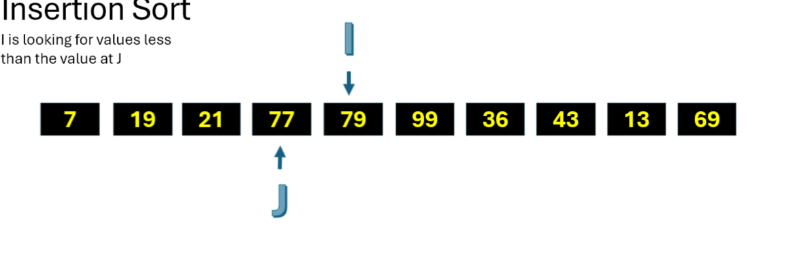
Insertion Sort - observations
After each loop over J, everything up to I is in sorted order, BUT we still haven’t looked at elements after I. So we don’t have a partial result yet
Instead of always looping over J every time I moves to the next position, we could look at the next value. If it’s higher, then we can skip the loop over J and move on to the next I.

Slide 9
Selection Sort

Slide 10

Selection Sort
I
21
79
7
19
77
99
36
43
13
69
J
Inner loop (faster)
J scans elements to the right of I
If A[I] and A[J] are out of order, swap them
Increment I

Slide 11
Selection Sort - Animation
I
21
79
7
19
77
99
36
43
13
69
J is looking for values less than the value at I
J
pseudocode
for (I = 0 to LENGTH-2) {
for (j = 1 to LENGTH-1) {
if (A[I] > A[J]) {
doSwap(I,J);
}
}
}

Slide 12
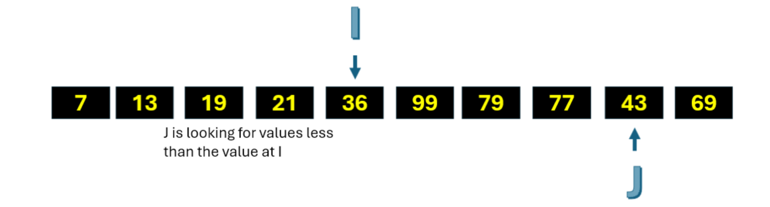
Selection Sort - observations
Every time we move J, maybe look to see if it’s the start of a long run of equal values. We can then move them in batch, and I can take a bigger step.
Everything to left of I is already in its final position, so if you only want the first I, you can stop already.
Once I catches up with a high value, it’s likely to get swapped out in the next. Maybe there’s an opportunity to intervene and sort the remainder of the array before the next loop over J.

Slide 13
Bubble Sort

Slide 14
Bubble Sort
I
Outer loop (slower)
21
79
7
19
77
99
36
43
13
69
J
Inner loop (faster)
The highest element “bubbles” towards I by swapping A[J], A[J+1] if out of order.
After each iteration of J, I is decremented

Slide 15
Bubble Sort - Animation
I
21
79
7
19
77
99
36
43
13
69
J
pseudocode
for (I = LENGTH-1 to 1) {
for (J=0 to I-1) {
if (A[I]>A[J+1]) {
doSwap(I,J+1);
}
}
}

Slide 16
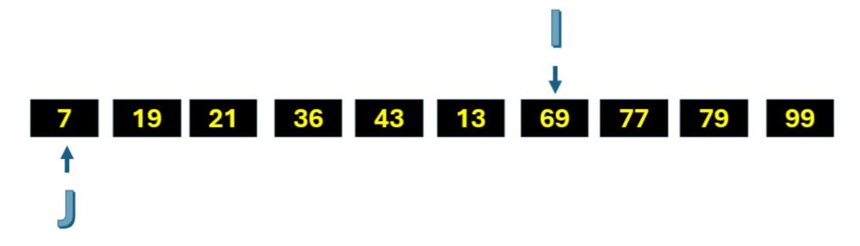
Bubble Sort - observations
Everything to the right of I is already sorted, so we can stop here if that’s all we need
Very small values will only be moved to the left one step at a time. Combing sort is a technique where the step size is N>1, and achieves bigger steps at the expense of having to break the array into N parts.
If no swap is needed in any loop over J, we can stop the sort early.

Slide 17
Merge Sort
We did this last week – quick revision

Slide 18
Merge Sort
We did Merge Sort last week
Recursive call structure
In each recursion:
Split the array into two sub-arrays
Call itself once for each new sub-array
“sort merge” the newly sorted sub-arrays to return larger sorted array

Slide 19
Merge Sort – divide before conquer
21
79
19
7
77
99
36
43
13
69
21
79
19
7
77
99
36
43
divide
divide
21
79
19
7
77
99
36
43
divide
21
79
19
7
77
99
36
43
13
69
divide
21
79
7
19
77
99
36
43
13
69

Slide 20
Merge Sort – do sort merge at end of each recursion
21
79
19
7
77
99
36
43
13
69
1
2
1
2
1
2
1
2
21
79
7
19
77
99
36
43
1
2
3
4
1
2
3
4
7
19
21
79
36
43
77
99
1
2
3
4
5
6
7
8
1
2
7
19
21
36
43
77
79
99
13
69
1
2
3
4
5
6
7
8
9
10
7
13
19
21
36
43
69
77
79
99

Slide 21
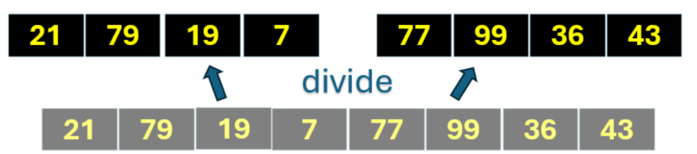
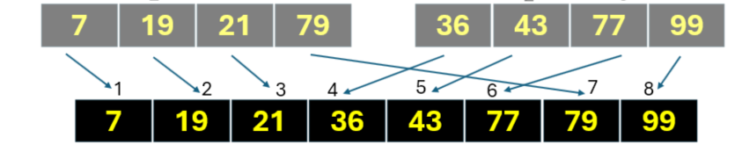
Pseudocode: recursive function call
Merge Sort
function mergeSort (start, end) { // start, end of sub-array
if (start == end) return; // can’t go on forever
divider = somewhere_in_between_start_end(start, end)
// for (0,10) I chose 8 because it’s a power of 2, for (0,8) I chose 4
// but you can also just go halfway, it’ll still work
mergeSort (start, divider);
mergeSort (divider, end);
sortmerge(start->divider, divider->end);
// this is what is happening in between each row
}

Slide 22
Call structure: recursive function call
Merge Sort
merge (0, 10)
14
16
1
15
merge (0, 8)
merge (8, 10)
7
13
2
8
merge (0, 4)
merge (4, 8)
4
5
12
3
6
11
10
9
merge (0, 2)
merge (2, 4)
merge (4, 6)
merge (6, 8)

Slide 23
Quick Sort

Slide 24
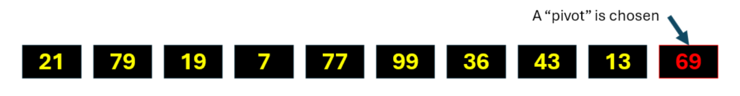
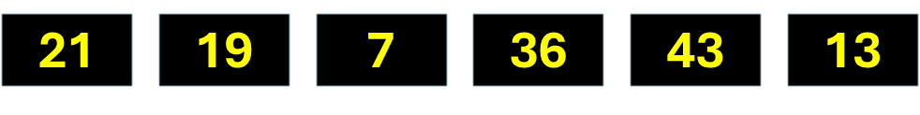
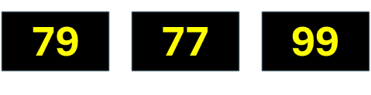
Quick Sort
Recursive call structure (like Merge Sort)
In each recursion:
Choose an array element as the “pivot” (usually the last – or first – for convenience)
Create the left sub-array from the other elements which are smaller than (or equal to) the “pivot”
Create the right sub-array from the other elements
Call itself recursively twice, passing the left and right sub-arrays respectively
Cards demo

Slide 25
Quick Sort – Animation Part 1
A “pivot” is chosen
21
79
19
7
77
99
36
43
13
69
21
19
7
36
43
13
69
79
77
99
The algorithm is recursively applied to the two sub-arrays
P1
These will be the new pivots in the next recursion
The pivot is locked in place. It’s in the right position, and has split the array into one/two sub-arrays

Slide 26
Quick Sort – Animation Part 2
21
79
19
7
77
99
36
43
13
69
21
19
7
36
43
13
69
79
77
99
P1
7
13
21
19
36
43
79
77
99
P2
P8
7
21
19
36
43
77
79
P3
21
19
36
P4
P9
P10
19
21
P5
P6
P7

Slide 27
Pseudocode: recursive function call
Quick Sort
Pivot value
function quicksort (start, len) { // start, len of sub-array
if (len==1) return; // no more to do
pivot = A[start + len -1] // last element
left_sub_array = [ <= pivot but not pivot itself ]
right_sub_array = [ > pivot ]
pivot_position = start + left_sub_array_len
A[pivot_position] = pivot
quicksort (start, left_sub_array_len);
quicksort (pivot_position+1, right_sub_array_len);
}
len
start
left_sub_array
right_sub_array
Pivot_position

Slide 28


Caveat about recursion
You can (and maybe should) avoid recursion in professional code
Every function call consumes stack space
Stack size is limited (typically a few 100k bytes, but in memory-constrained platforms could be much lower)
The stack space is only released when the function returns
So with recursion, this means at the end
Algorithms don’t usually strictly require recursion:
They talk about state and operations on that state
Recursion is a programming technique where an operation also calls itself before returning
Instead you can iterate (loop) and apply operations (which return) in each iteration
Recursion is elegant
Iteration is practical

Slide 29

Complexity
Big O notation, $N^{r}, \log{N}$

Slide 30
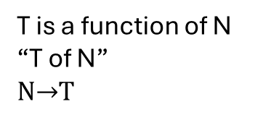
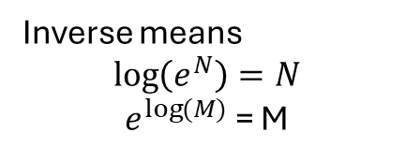

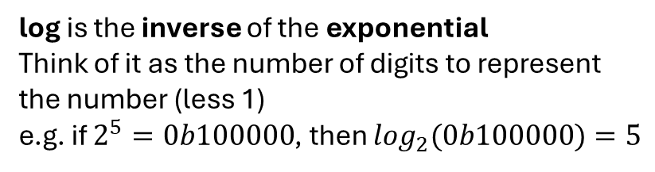
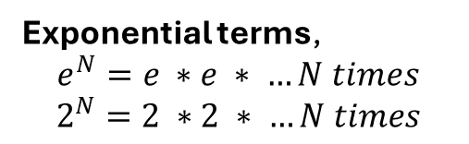
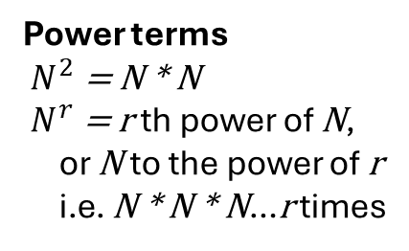
Maths Check
Complexity
Don’t worry about the actual equation. It’s only there to show examples of the terms we will be using.
T, N are variables, everything else is a fixed constant or a function, like log
T is a function of N
“T of N”
NT
$T\left(N\right)=A{ ∗N}^{2}{+ B∗N}^{r}$ $+e^{N} +\log{N}$
coefficient
log is the inverse of the exponential
Think of it as the number of digits to represent the number (less 1)
e.g. if $2^{5}=0b100000$, then $\log_{2}(0b100000)=5$
Power terms
${ N}^{2}$= N * N
${ N}^{r}$= r th power of N,
or N to the power of r
i.e. N * N * N…r times
Exponential terms,
$$e^{N}=e ∗e ∗ …N times$$
$$2^{N}=2 ∗2 ∗ …N times$$
Inverse means
$$\log\left(e^{N}\right)=N$$
$e^{\log{(M)}}$ = M

Slide 31
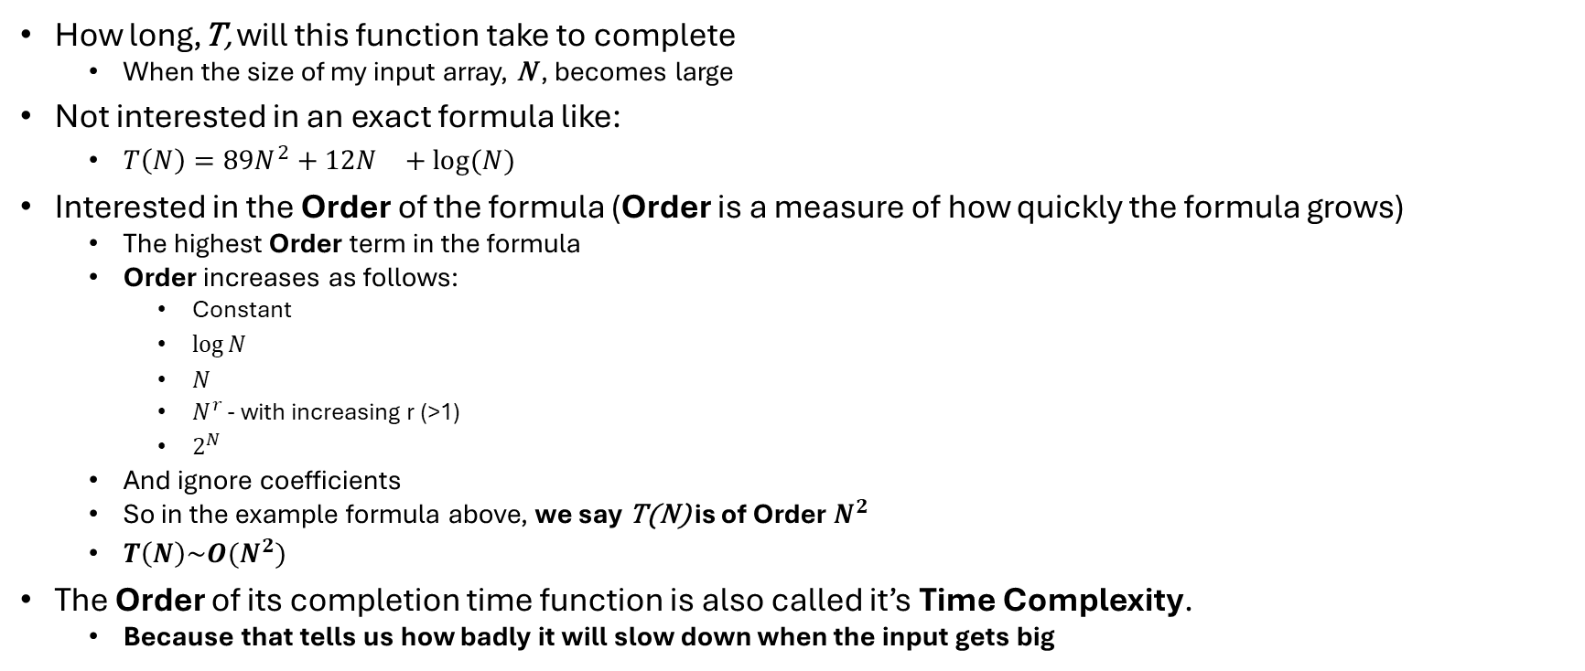
Time Complexity
Complexity
How long,T, will this function take to complete
When the size of my input array, N , becomes large
Not interested in an exact formula like:
$T\left(N\right)={89N}^{2}+12N^{}+log⁡(N)$
Interested in the Order of the formula (Order is a measure of how quickly the formula grows)
The highest Order term in the formula
Order increases as follows:
Constant
$\log{N}$
$N$
$N^{r}$ - with increasing r (>1)
$2^{N}$
And ignore coefficients
So in the example formula above, we say T(N) is of Order $N^{2}$
$T\left(N\right)\sim O(N^{2})$
The Order of its completion time function is also called it’s Time Complexity.
Because that tells us how badly it will slow down when the input gets big

Slide 32
Why only the highest order matters
Complexity
Scaling important
Can live with this
Coefficients in T don’t matter. You can divide the coefficient by any number you like, the Order term will always take over.
e.g. a newer computer might have twice the speed, eventually the scaling behaviour ot the algorithm will dominate.

Slide 33
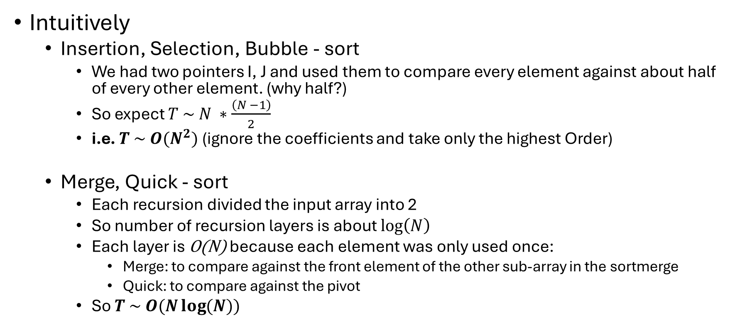
Time Complexity of our 5 Sorting Algorithms
Complexity
Intuitively
Insertion, Selection, Bubble - sort
We had two pointers I, J and used them to compare every element against about half of every other element. (why half?)
So expect $T \sim N ∗\frac{\left(N −1\right)}{2}$
i.e. $T \sim O(N^{2})$ (ignore the coefficients and take only the highest Order)
Merge, Quick - sort
Each recursion divided the input array into 2
So number of recursion layers is about $\log\left(N\right)$
Each layer is O(N) because each element was only used once:
Merge: to compare against the front element of the other sub-array in the sortmerge
Quick: to compare against the pivot
So $T \sim O(N\log{(N)})$

Slide 34
Stability

Slide 35
Stability
A sorting algorithm is stable if elements with equal keys remain in the same order after sorting
true | Mango
false | Banana
true | Apple
false | Grape
true | Peach
true | Mango
true | Apple
true | Peach
false | Banana
false | Grape
Sort by col 1
Of the 5 algorithms, we’ve seen so far, only selection sort is not stable. But it can be implemented to be stable.

Slide 36
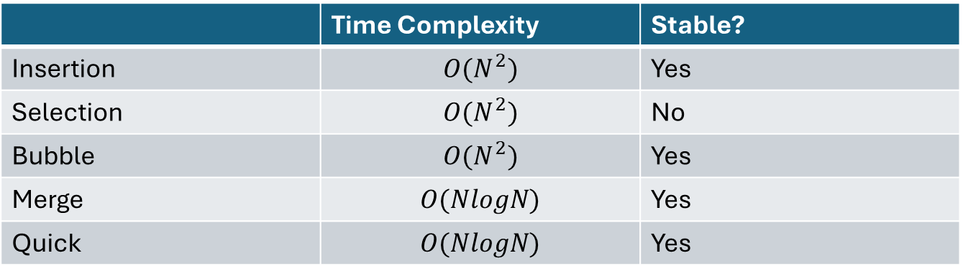
Recap
 | Time Complexity | Stable?
Insertion | $$O(N^{2})$$ | Yes
Selection | $$O(N^{2})$$ | No
Bubble | $$O(N^{2})$$ | Yes
Merge | $$O(NlogN)$$ | Yes
Quick | $$O(NlogN)$$ | Yes

Slide 37
Special Cases

Slide 38
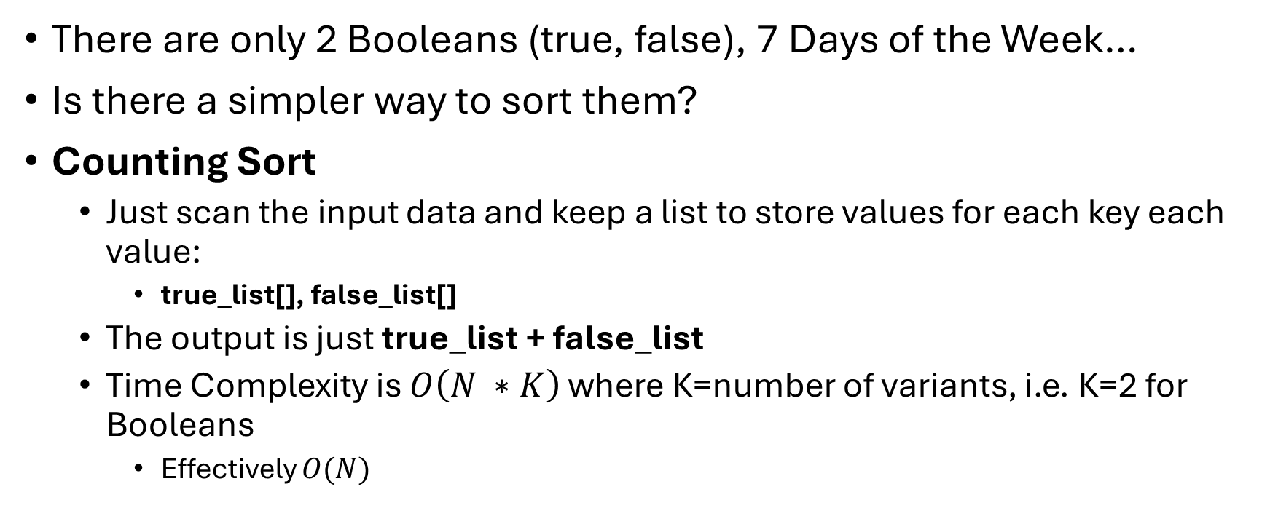
Sorting Booleans, Types with a limited number of variants
Special cases
There are only 2 Booleans (true, false), 7 Days of the Week…
Is there a simpler way to sort them?
Counting Sort
Just scan the input data and keep a list to store values for each key each value:
true_list[], false_list[]
The output is just true_list + false_list
Time Complexity is $O\left(N ∗K\right)$ where K=number of variants, i.e. K=2 for Booleans
Effectively $O(N)$

Slide 39
Radix Sort
Special cases
Composite keys:
Key = [key1, key2, key3….]
E.g.
Fixed-length strings, “aaa”, “aba”, “paa”…
[ CompanyID, DepartmentID, JobTitle ]
Radix sort:
Sort by one key at a time, possibly using one of the previous algorithms, like counting sort
Least Significant Key First:
Requires stable algorithm, so order of secondary keys is preserved
Most Significant Key First:
Sort into lists for each key, then sort each list using the next key
Demo

Slide 40
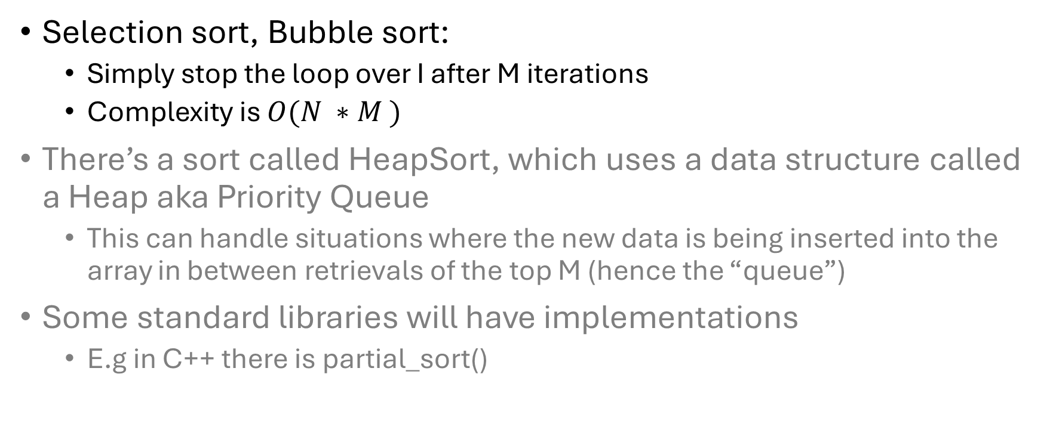
If we only need the first M results
Special cases
Selection sort, Bubble sort:
Simply stop the loop over I after M iterations
Complexity is $O(N ∗M )$
There’s a sort called HeapSort, which uses a data structure called a Heap aka Priority Queue
This can handle situations where the new data is being inserted into the array in between retrievals of the top M (hence the “queue”)
Some standard libraries will have implementations
E.g in C++ there is partial_sort()

Slide 41
Multithreading
Special cases
MergeSort and QuickSort
Divide and Conquer approach means multiple threads can be run on sub-arrays which are protected from interference from other threads
In MergeSort the sub-array memory locations are fixed by the division method
In QuickSort they are determined by the position of the pivot
Insertion, Selection and Bubble
Not easy to do multithreading because elements are being moved all over the array generally, you can’t protect them for each thread.

Slide 42
Combing Sorts
Special cases
A divide and conquer approach:
Split the array into P arrays by taking every Pth element
P=4
Sort each array separately
Then put them back together
Two new names to drop:
Combing + InsertionSort => ShellSort
Combing + BubbleSort => CombSort
Repeat with a smaller value of P until P=1

Slide 43
A look ahead to Data Structures
In sorting algorithms, we talked about arrays.
When we get on to linked lists and other data structures, the story about time complexity changes completely.
Which is why Data Structures and Algorithms are usually grouped together when they are studied.

Slide 44
Not really homework but you might like to see
Javascript generated animation app of the 5 Algorithms
https://compsci-sorting-algorithms.netlify.app/
Webpage: https://github.com/wai-t/CompSci/blob/main/ComputerScience/index.html
Implementation: https://github.com/wai-t/CompSci/blob/main/ComputerScience/sorting_algorithms.js
Can you see where it can be improved to be more efficient:
Review the observations made in the previous slide
Add some monitoring to count the number of times array elements are looked at and moved to a new position, and compare these counts for each algorithm

Slide 45
End of Workshop
Thank you for listening!

